Slide 1

Exception-enriched Rule Learning from Knowledge Graphs
Mohamed GadElrab, Daria Stepanova, Jacopo Urbani & Gerhard Weikum
ISWC 2016
17-21Oct Kobe, Japan
5th August 2016

Slide 2
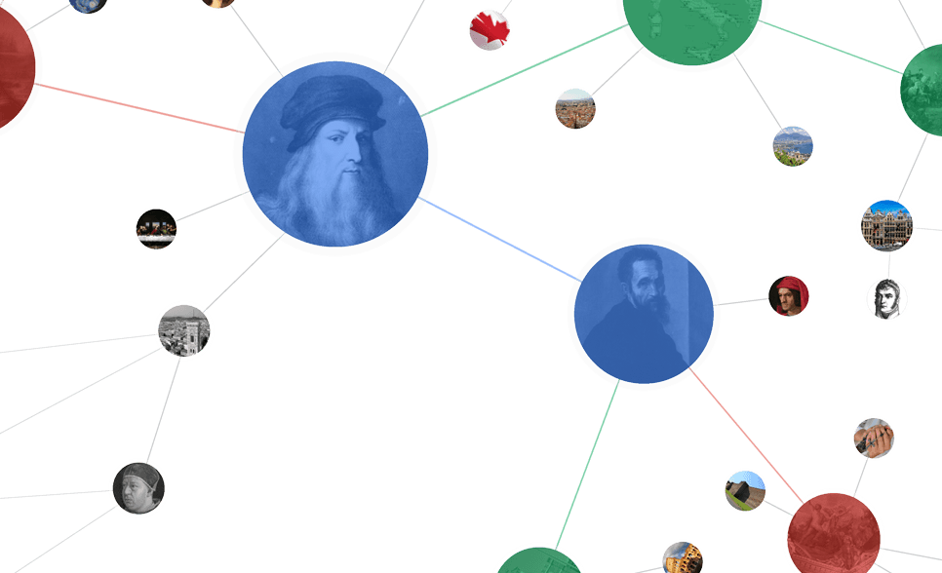


Learning Rules from Knowledge Graphs (KGs)
Brad
isMarriedTo
Ann
hasBrother
John
isMarriedTo
Kate
livesIn
livesIn
livesIn
livesIn
Berlin
Researcher
Chicago
livesIn
isA
isA
livesIn
Bod
isMarriedTo
Alice
Dave
isMarriedTo
Clara
plays
likes
livesIn
Hockey
Classic Music
Amsterdam
r_{rev} : livesIn(X,Z) ← isMarriedTo(X,Y), livesIn(Y,Z)

Slide 3
Exceptions in KGs
Brad
isMarriedTo
Ann
hasBrother
John
isMarriedTo
Kate
livesIn
livesIn
livesIn
livesIn
Berlin
Researcher
Chicago
livesIn
isA
isA
!?
livesIn
Bod
isMarriedTo
Alice
Dave
isMarriedTo
Clara
plays
like
livesIn
Hockey
Classic Music
Amsterdam
r_{rev} : livesIn(X,Z) ← isMarriedTo(X,Y), livesIn(Y,Z)

Slide 4
Non-monotonic Rule Learning
Revising Horn rules into Nonmonotonic rules
that can describe the Knowledge Graph &
predict more facts accurately
Brad
isMarriedTo
Ann
hasBrother
John
isMarriedTo
Kate
livesIn
livesIn
livesIn
livesIn
Berlin
Researcher
Chicago
livesIn
isA
isA
!?
livesIn
Bod
isMarriedTo
Alice
Dave
isMarriedTo
Clara
plays
like
livesIn
Hockey
Classic Music
Amsterdam
r_{rev} : livesIn(X,Z) ← isMarriedTo(X,Y), livesIn(Y,Z), not researcher(X)

Slide 5
Start with Unary
Huge search space
livesIn(X,Z) ← isMarriedTo(X,Y), livesIn(Y,Z)
Unary predicates only:
Types
Propositionalization
Abstraction
<Barak_Obama> rdf:Type <Politician>
Politician(Barak_Obama)
<Michelle> <isMarriedTo> <Barak_Obama>
isMT_Barak_Obama(Michelle)
<Michelle> <livesIn> <USA>
livesIn_USA(Michelle)
<Albert_Einstein> <BornIn> <Ulm>
BornIn_Ulm(Albert_Einstein)
isMT_Barak_Obama(Michelle)
isMT_Politicion(Michelle)
isMT_Albert_Einstein(Elsa_Einstein)
isMT_Scientist(Elsa_Einstein)
BornIn_Ulm(Albert_Einstein)
BornIn_Germany(Albert_Einstein)
livesIn_USA(Michelle)
livesIn_USA(Michelle)

Slide 6
Step 1: Horn Rules
r_{i}: livesInUSA(X) ← bornInUSA(X)
 | BornInUS | LivesInUSA | Stateless | Immigrant | singer | poet | hasUSPass
P1 | ✓ | ✓ |  |  |  |  | ✓
P2 | ✓ | ✓ |  |  |  |  | ✓
P3 | ✓ | ✓ |  |  |  |  | ✓
P4 | ✓ | ✓ |  |  | ✓ |  | ✓
P5 | ✓ | ✓ | ✓ |  |  |  | ✓
P6 | ✓ |  | ✓
P7 | ✓ |  | ✓
P8 | ✓ |  | ✓ | ✓ |  | ✓
P9 | ✓ |  |  | ✓ |  | ✓
P10 | ✓ |  |  | ✓ | ✓ | ✓
P11 | ✓ |  |  |  | ✓ | ✓ | ✓
E⁺
E⁻

Slide 7
Step 2: Exception Witness Set (EWS)
r_{i}: livesInUSA(X) ← bornInUSA(X)
 | BornInUS | LivesInUSA | Stateless | Immigrant | singer | poet | hasUSPass
P1 | ✓ | ✓ |  |  |  |  | ✓
P2 | ✓ | ✓ |  |  |  |  | ✓
P3 | ✓ | ✓ |  |  |  |  | ✓
P4 | ✓ | ✓ |  |  | ✓ |  | ✓
P5 | ✓ | ✓ | ✓ |  |  |  | ✓
P6 | ✓ |  | ✓
P7 | ✓ |  | ✓
P8 | ✓ |  | ✓ | ✓ |  | ✓
P9 | ✓ |  |  | ✓ |  | ✓
P10 | ✓ |  |  | ✓ | ✓ | ✓
P11 | ✓ |  |  |  | ✓ | ✓ | ✓
E⁺
E⁻
EWS ={immigrant(X), poet(X)}

Slide 8
Step 3: Candidate Revisions
Horn Rules Set
Revisions
⎨
r_{i-1} : poet(X) ← singer(X) EWS={guitarist(X), bornInUSA(X)}
r_{i} : livesInUSA(a) ← bornInUSA(a) EWS={poet(X), immigrant(X)}
r_{i+1}: immigrant(a) ← stateless(a) EWS={hasUSApassport(X), ….}
R_{h}
⎨
r_{i-1} : poet(X) ← singer(X), not guitarist(X)
r_{i} : livesInUSA(a) ← bornInUSA(a), not poet(X)
r_{i+1}: immigrant(a) ← stateless(a), not hasUSApassport(X)
R_{NM1}
…………
…………..
⎨
r_{i-1} : poet(X) ← singer(X), not bornInUSA(X)
r_{i} : livesInUSA(a) ← bornInUSA(a), not immigrant(X)
r_{i+1}: immigrant(a) ← stateless(a), not hasUSApassport(X)
R_{NM2}

Slide 9
Step 4: Selecting The Best Revision
Quality Functions
Independent Rules Quality measures (rm)
Confidence
conf(h ← b) = supp(h ← b)/supp(b)
Lift
lift(h ← b) = conf(h ← b)/supp(h)
Convection
…
Maximizing Group Quality
q_{rm}(R_{NM} , A) = ∑_{r∈Rnm} rm(r, A) / |R_{NM}|

Slide 10
Step 4: Selecting The Best Revision
Ruleset predictions Consistency
Negations introduce conflicts
Measuring conflicts (auxiliary rules)
r₁: livesInPakistan(a) ← playsCricket(a)
r₂: livesInPakistan(a) ← bornInPakistan(a), not immigrant(a)
a= Fawad_Ahmed¹
r : livesInUSA(X) ← bornInUSA(X), not immigrant(X)
r_{aux}: not_livesInUSA(X) ← bornInUSA(X), immigrant(X)
q_{conflict}(R_{NM} , A) = ∑_{p∈pred(Raux)} ( |{c| p(c), not_p(c) ∈ A_{Raux}}| / |{c| not_p(c) ∈ A_{Raux}}| )
http://www.workpermit.com/news/2014-03-03/australian-immigration-criticised-over-cricketers-citizenship

Slide 11
Step 4: Selecting The Best Revision
Search Space
Size = |EWS₁| X |EWS₂| X |EWS₃| X … |EWS_{|R|}|
Incremental Solution
buildRevision(R, A, k):
SortRules(R)
foreach r_{i} in R:
rank(ESW_{i})
E_{i}=pickTopK(ESW_{i} , A ,k ) // k=1
foreach e in E_{i}:
add(R_{NM} , h₁(a) ← B₁(a), not e(a))
r_{i-2} : … EWS={.......}
r_{i-1} : poet(X) ← singer(X) EWS={guitarist(X), bornInUSA(X)}
r_{i} : livesInUSA(a) ← bornInUSA(a) EWS={poet(X), immigrant(X)}
r_{i+1}: immigrant(a) ← stateless(a) EWS={hasUSApassport(X), ….}
r_{i+2}: … EWS={.......}
⎨
R_{h}

Slide 12
Step 4: Selecting The Best Revision
Naive-Ranker
Only based on supp(e) in E⁻(r)
Errors due to incompleteness
LivesInUSA(X) ← BornInUSA(X)
 | BornInUS | LivesInUSA | Stateless | Immigrant | singer | poet | hasUSPass
.. | ... | ... | ... | ... | ... | ... | ....
P6 | ✓ |  | ✓
P7 | ✓ |  | ✓
P8 | ✓ |  | ✓ | ✓ |  | ✓
P9 | ✓ |  |  | ✓ |  | ✓
P10 | ✓ |  |  | ✓ | ✓ | ✓
P11 | ✓ |  |  |  | ✓ | ✓ | ✓
supp(poet(X)) > supp(immigrant(X))

Slide 13
Step 4: Selecting The Best Revision
Partial Materialization
r_{i-2} : … EWS={.......}
r_{i-1} : poet(X) ← singer(X) EWS={guitarist(X), bornInUSA(X)}
r_{i} : livesInUSA(a) ← bornInUSA(a) EWS={poet(X), immigrant(X)}
r_{i+1}: immigrant(a) ← stateless(a) EWS={hasUSApassport(X), ….}
r_{i+2}: … EWS={.......}
⎨
R_{h}

Slide 14
Step 4: Selecting The Best Revision
Partial Materialization
r_{i}: livesInUSA(X) ← bornInUSA(X)
 | BornInUS | LivesInUSA | Stateless | Immigrant | singer | poet | hasUSPass
P1 | ✓ | ✓ |  |  |  |  | ✓
P2 | ✓ | ✓ |  |  |  |  | ✓
P3 | ✓ | ✓ |  |  |  |  | ✓
P4 | ✓ | ✓ |  |  | ✓ | ✓ | ✓
P5 | ✓ | ✓ | ✓ |  |  | ✓ | ✓
P6 | ✓ | ✓ | ✓
P7 | ✓ |  | ✓ | ✓
P8 | ✓ |  | ✓ | ✓ |  | ✓
P9 | ✓ |  |  | ✓ |  | ✓
P10 | ✓ |  |  | ✓ | ✓ | ✓
P11 | ✓ |  |  | ✓ | ✓ | ✓ | ✓
E⁺
E⁻

Slide 15
Step 4: Selecting The Best Revision
Partial Materialization
New Ranking Function
r_{i-2} : … EWS={.......}
r_{i-1} : poet(X) ← singer(X) EWS={guitarist(X), bornInUSA(X)}
r_{i} : livesInUSA(a) ← bornInUSA(a) EWS={poet(X), immigrant(X)}
r_{i+1}: immigrant(a) ← stateless(a) EWS={hasUSApassport(X), ….}
r_{i+2}: … EWS={.......}
⎨
R_{h}
Score_{e}(r, A^{R}) = 0.5 (rm (r_{e}, A^{R})+ rm (r_{e} ^{aux}, A^{R}))

Slide 16
Step 4: Selecting The Best Revision
OPM-ranker (PM + Order)
Only consider Rules with better quality (i.e Lift)
OWPM-ranker (OPM + Weights)
Transactions with predicted atoms are weighted
r_{i-2} : … EWS={.......}
r_{i-1} : poet(X) ← singer(X) EWS={guitarist(X), bornInUSA(X)}
r_{i} : livesInUSA(a) ← bornInUSA(a) EWS={poet(X), immigrant(X)}
r_{i+1}: immigrant(a) ← stateless(a) EWS={hasUSApassport(X), ….}
r_{i+2}: … EWS={.......}
⎨
R_{h}
r_{i-2} : … EWS={.......}
r_{i-1} : poet(X) ← singer(X) EWS={guitarist(X), bornInUSA(X)}
r_{i} : livesInUSA(a) ← bornInUSA(a) EWS={poet(X), immigrant(X)}
r_{i+1}: immigrant(a) ← stateless(a) EWS={hasUSApassport(X), ….}
r_{i+2}: … EWS={.......}
W=0.7
⎨
W=0.6
R_{h}

Slide 17
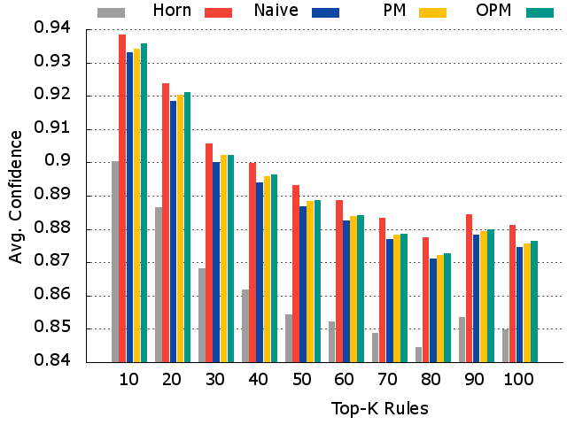
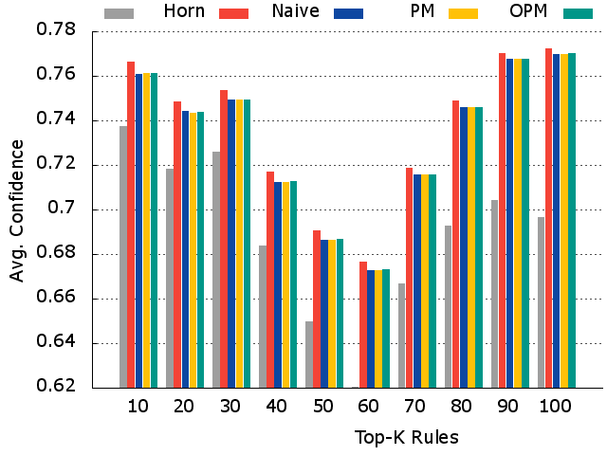
Evaluation
Revision Quality
Sorted by lift
Yago 10M, IMDB 2M
Yago
IMDB
*Higher is better

Slide 18
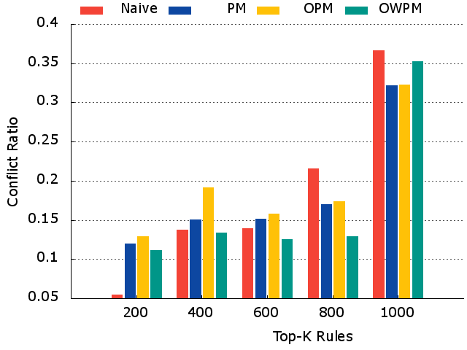
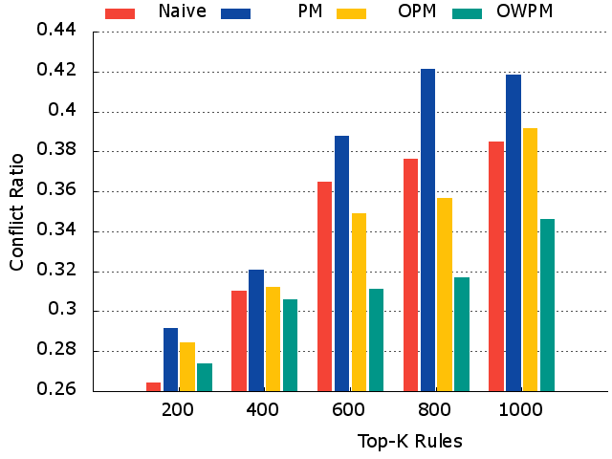
Evaluation
Conflicts
Sorted by lift
Yago
IMDB
*lower is better

Slide 19
Evaluation
Predictions
A
A+R^{OWPM}
A+R^{Horn}
Dataset | Horn | Naive | PM | OPM | OWPM | Removed Erroneous
YAGO | 924K | 888K | 892K | 892K | 891K | 73%

Slide 20
Examples
Y1 : isMountain(X) ← isLocatedInAustria(X), isLocatedInItaly(X)
, not [ isRiver (X) | isLocatedInRussia(X) ]
Y2 : bornInUSA(X ) ← actedInMovie(X), createdMovie(X), isPerson(X)
, not [ wonFilmfareAwards(X) | bornInNewYork (X)]
Y3 : isPoliticianOfUSA(X) ← bornInUSA(X), isGovernor (X)
, not [ isPoliticianPuertoRico(X) | isPoliticianOfHawaii(X) ]
I1 : hasLanguageEnglish(X) ← hasGenreDrama(X), hasGenreTriller(X), hasGenreCrime(X),
not [ producedInIndia(X) | createdByNovelist(X) ]
I2 : hasGenreAnimation(X) ← directedByActor(X), hasLanguageEnglish(X), producedUSA(X), hasGenreFamily(X),
not [ hasGenreDrama(X) | producedIn1984(X) ]

Slide 21
Next Steps!
Evidences from Knowledge Graphs is not Enough! Evidences from Text!?
Correlation between predicates!
Searching for positive and negative examples through guided extraction
poet(X) ← singer(X)
“....P4 was born in USA. He was famous for his poem. He lived in USA and died there…..”
 | BornInUS | LivesInUSA | Stateless | Immigrant | singer | poet | hasUSPass
P4 | ✓ | ✓ |  |  | ✓ | ✓ | ✓
“.. Amy Lou Adams was born in Vicenza, Veneto, Italy, to American parents …. She was nominated five times to the oscar but never won It....”

Slide 22

The rule: "there are exceptions to every rule"
is the only rule without exceptions,
making itself the only exception to the rule.
Thank you!

